Slide 1
Voltage control for power transfer in Ad Hoc DC Microgrids
Cephas

Slide 2
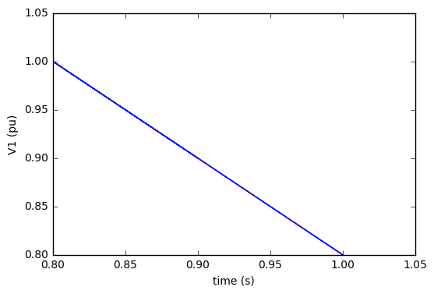
$$V_{1}=V_{m}m\left(V_{2}−V_{m}\right)$$

Slide 3
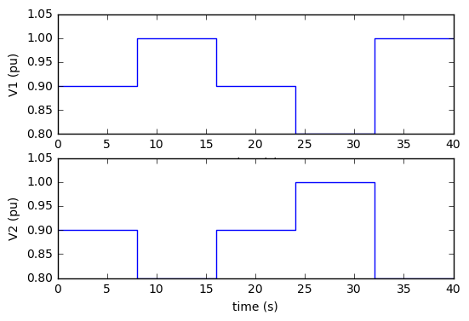
Simulation of V1 & V2 with varying current
a. Purely resistive line
b. RL line

Slide 4
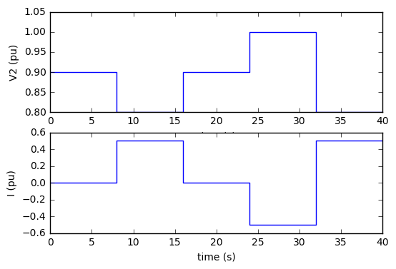
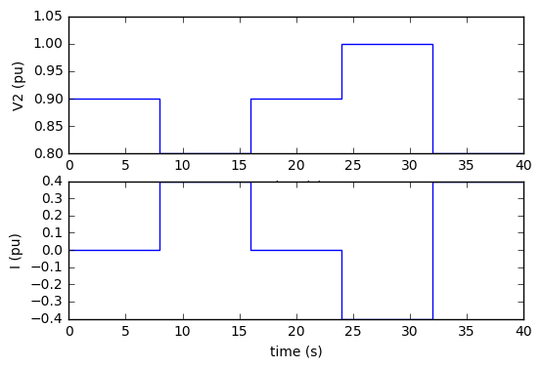
Response of V2 to change in current
a. Purely resistive line
b. RL line

Slide 5
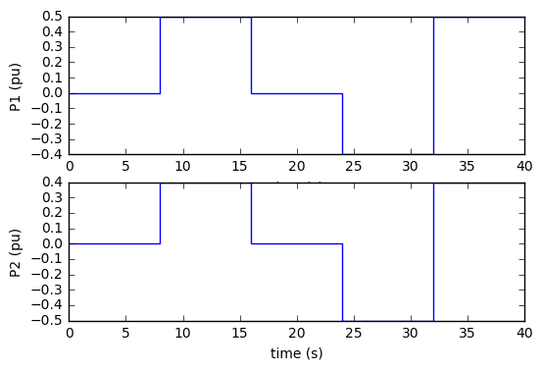
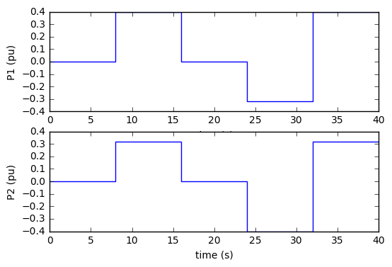
Simulation of P1 & P2 with varying current
a. Purely resistive line
b. RL line

Slide 6
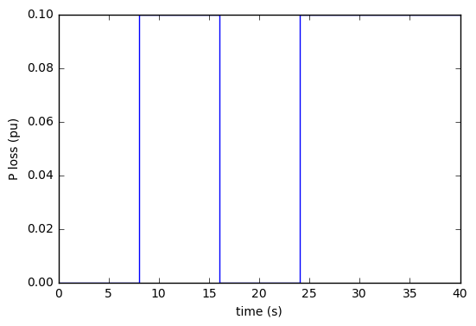
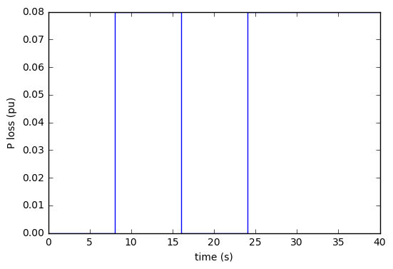
Power loss in the line
a. Purely resistive line
b. RL line

Slide 7
Thank you

